Slide 1
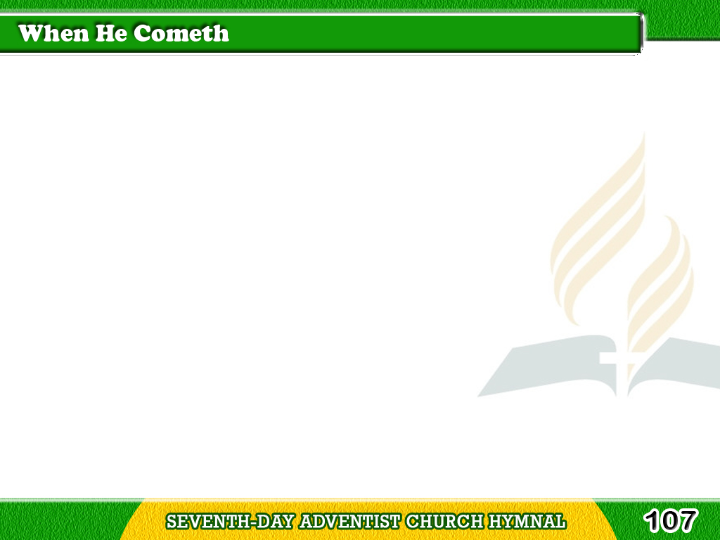
1/3
When He cometh,
when He cometh
To make up His jewels,
All His jewels, precious jewels,
His loved and His own.
Tagalog
Version

Slide 2
1/3
Like the stars of the morning,
His bright crown adorning,
They shall shine in their beauty,
Bright gems for His crown.
Tagalog
Version

Slide 3
2/3
He will gather, He will gather
The gems for His kingdom,
All the pure ones,
All the bright ones,
His loved and His own.
Tagalog
Version

Slide 4
2/3
Chorus
Like the stars of the morning,
His bright crown adorning,
They shall shine in their beauty,
Bright gems for His crown.
Tagalog
Version

Slide 5
3/3
Little children, little children
Who love their Redeemer,
Are the jewels, precious jewels,
His loved and His own.
Tagalog
Version

Slide 6
3/3
Chorus
Like the stars of the morning,
His bright crown adorning,
They shall shine in their beauty,
Bright gems for His crown.
Tagalog
Version

